Slide 1
MLOps Presentation
5 Dec. 2023
Bilal Naseem (MSDS IBA) | Salman Malik (MSDS IBA)

Slide 2
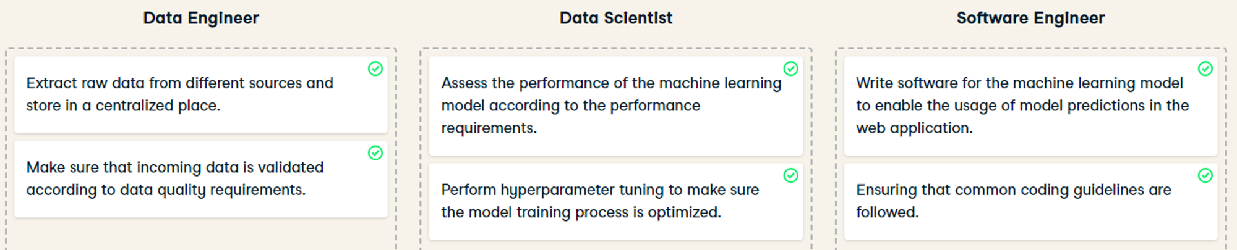
Introduction
ML model that exists in business processes rather than in just laptop
MLOps originates from DevOps
DevOps make software deployment efficient

Slide 3
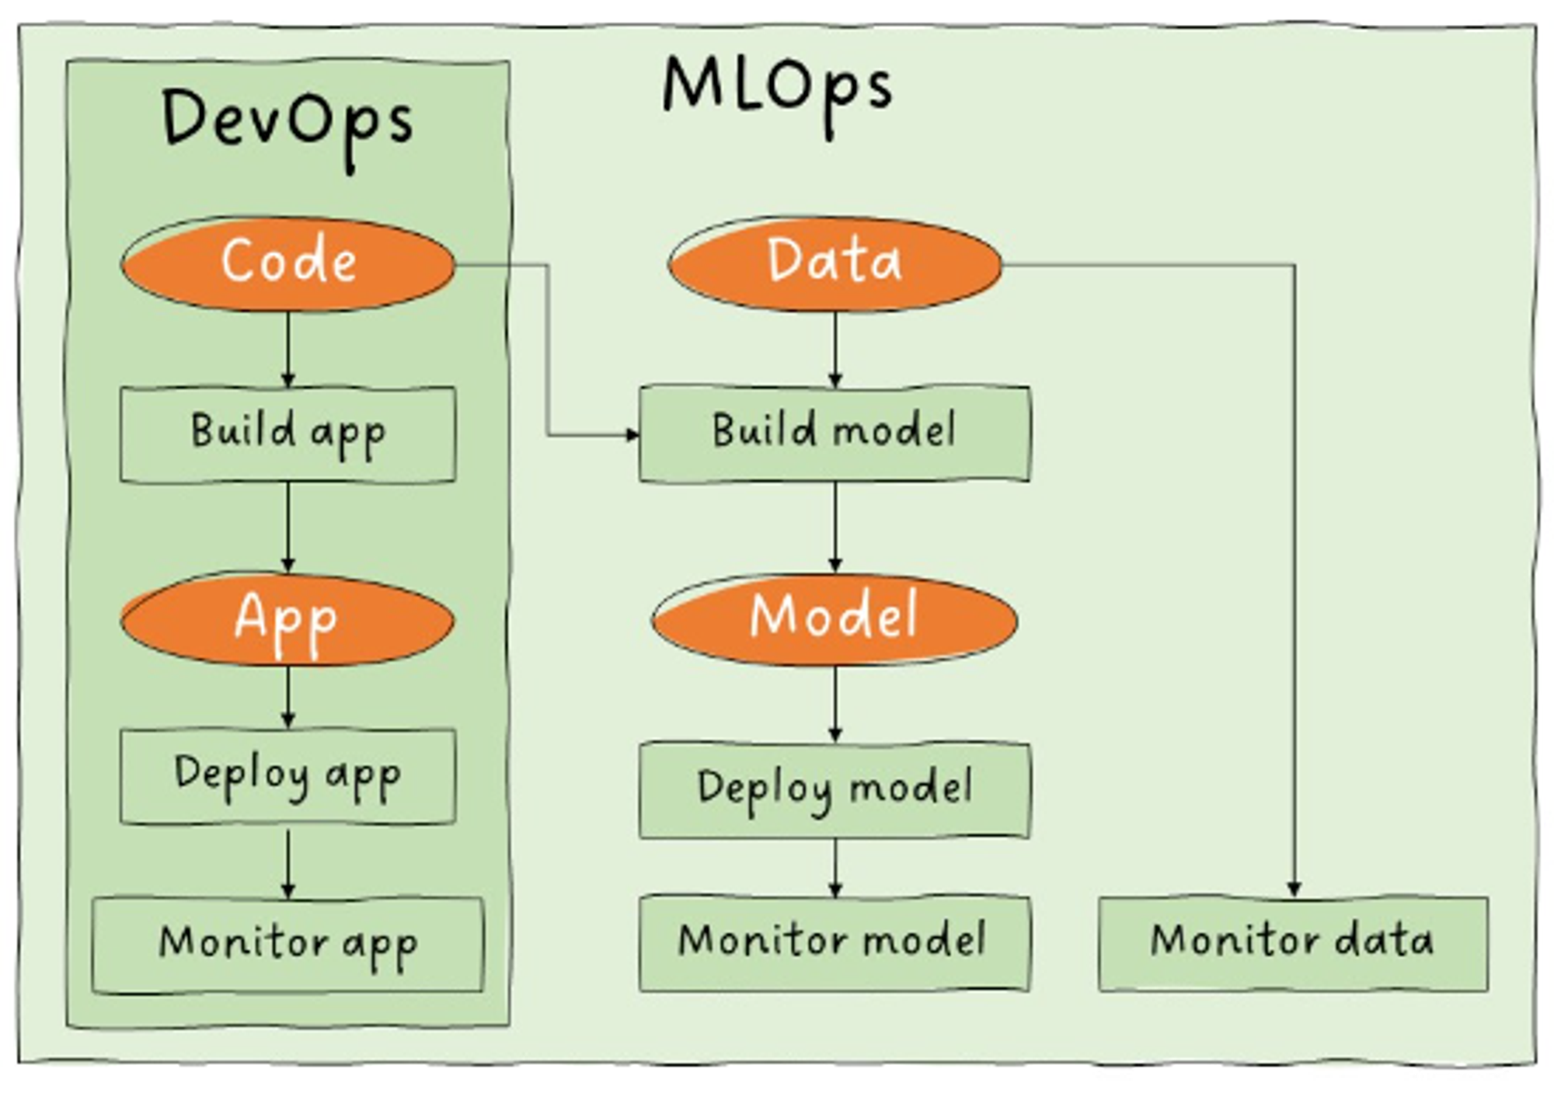
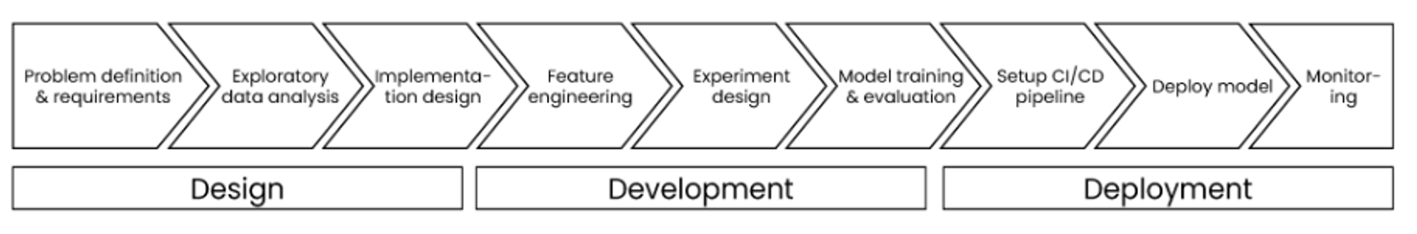
Introduction
ML workflow automation = MLOps maturity
Performance of model depends on quality of data
Data ingestions is done through a pipeline (ETL)

Slide 4
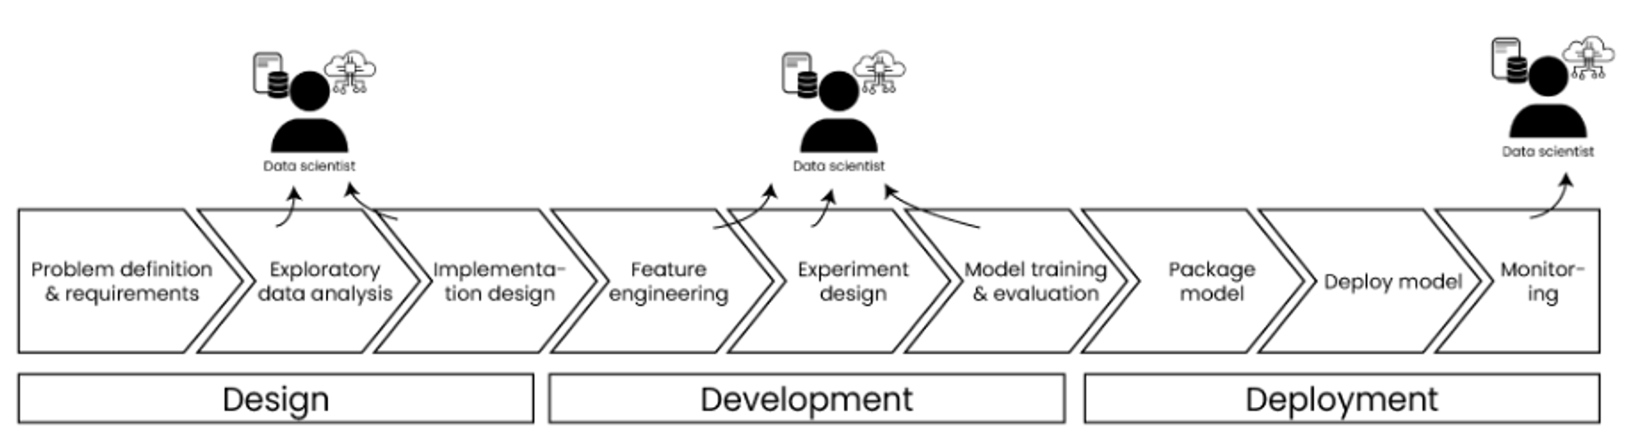

Slide 5
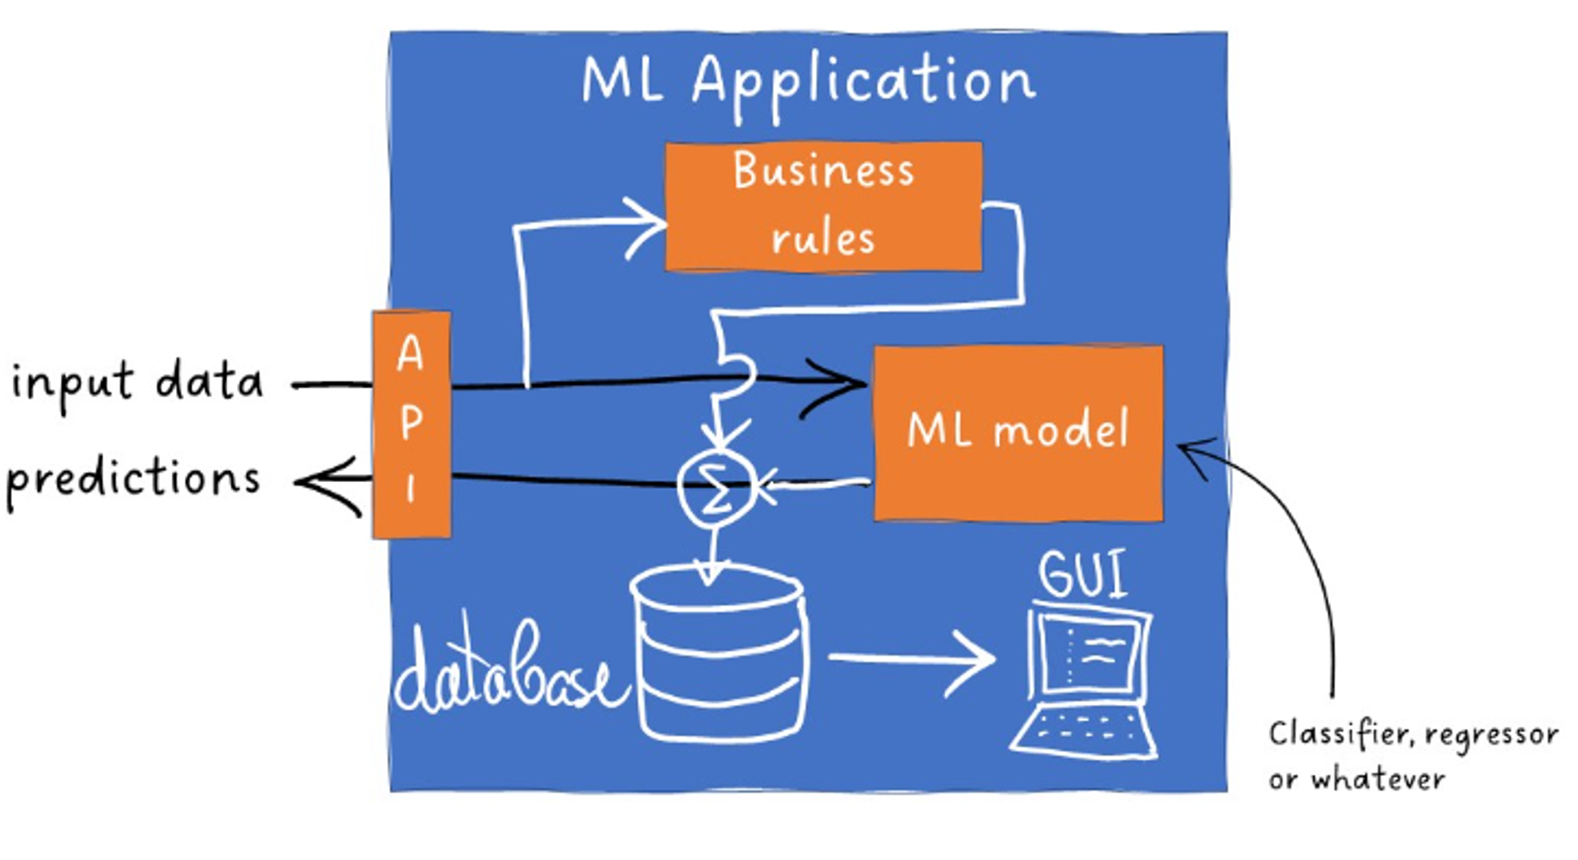

Slide 6
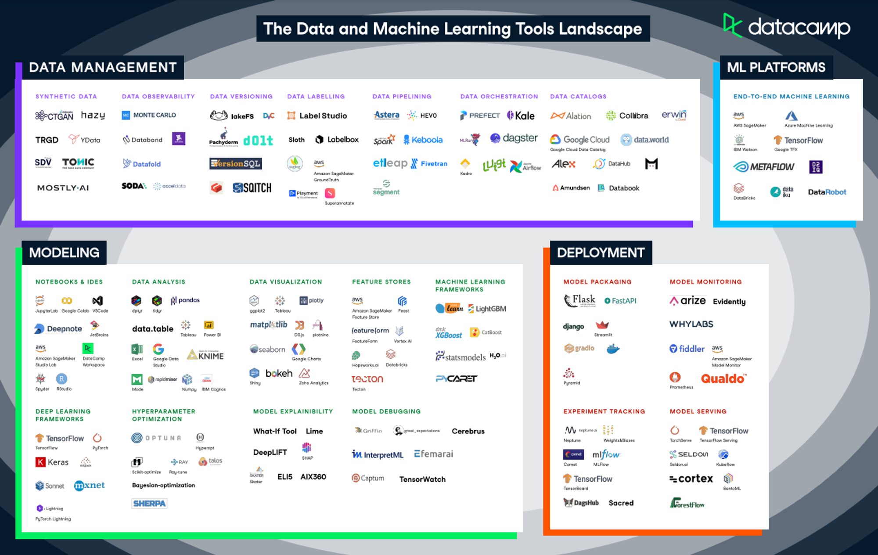

Slide 7
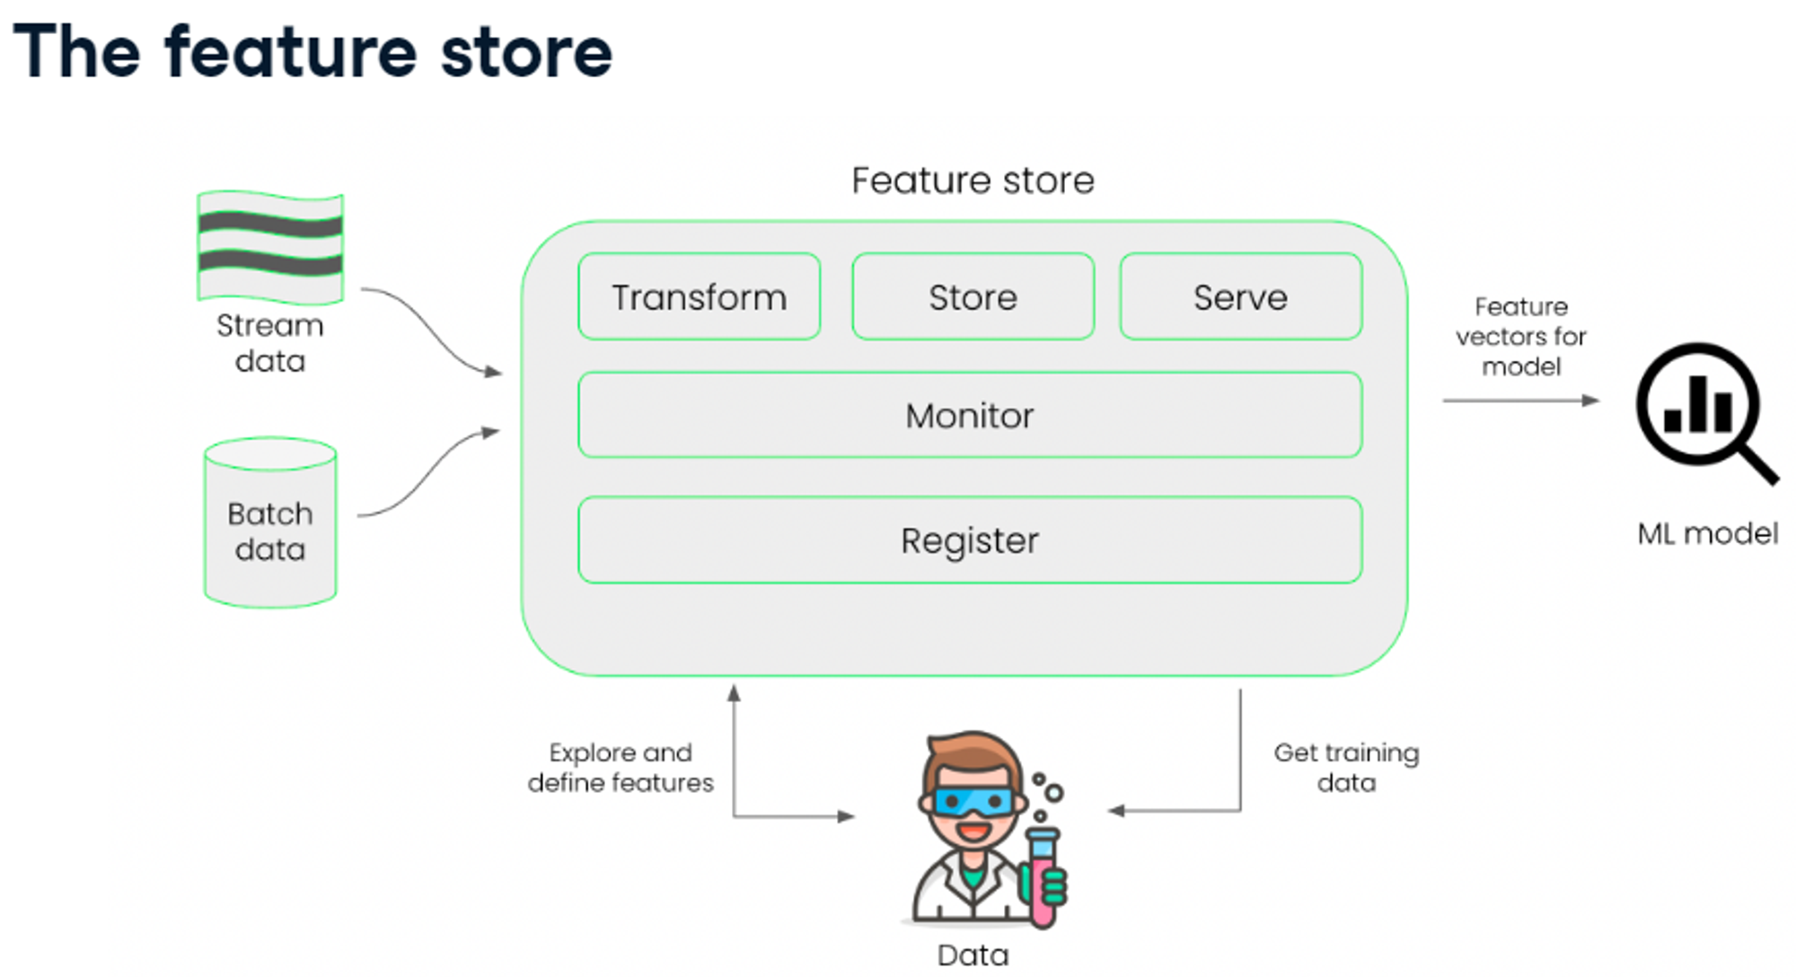
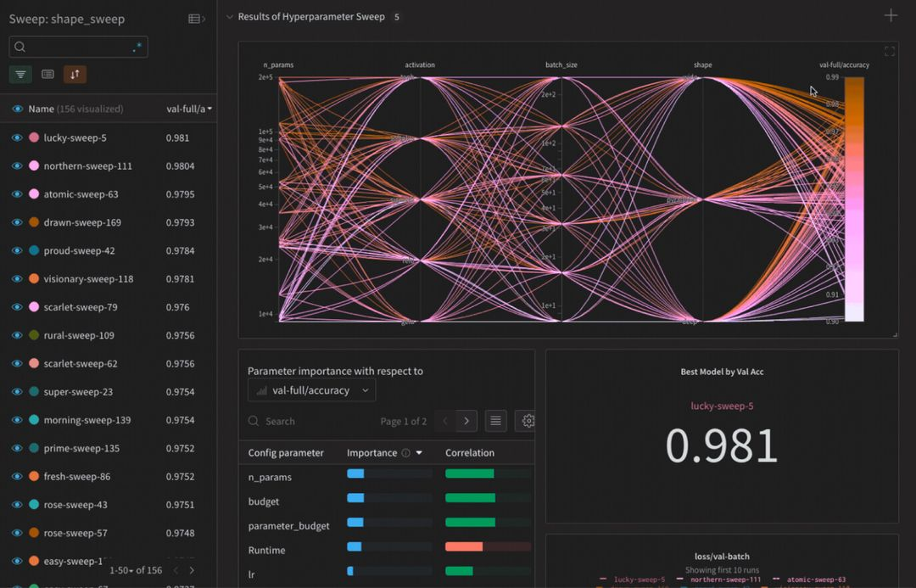
Development Stage
Feature Store:
A feature store is a tool for storing commonly used features or variables relevant to the machine learning model.
A tool for storing commonly used features.
Experiment Tracking:
A feature store is a tool for storing commonly used features or variables relevant to the machine learning model.
A tool for storing commonly used features.

Slide 8
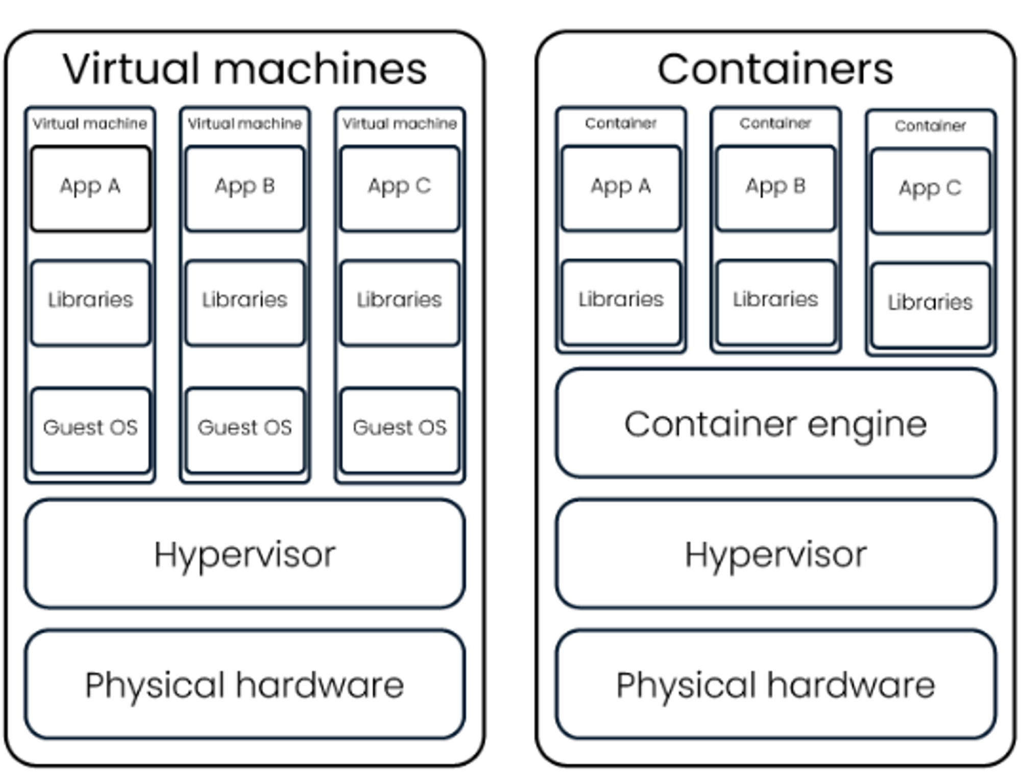
Deployment Stage
Development takes place in development environment - local computer or virtual (cloud computer)
For production = production environment
model will make predictions on actual incoming data
model is live
Development and production environment are different runtime environments
Libraries may be of different version
ML model is deployed as a microservice
Containers use less resources than a VM
Are more portable than applications on VM

Slide 9
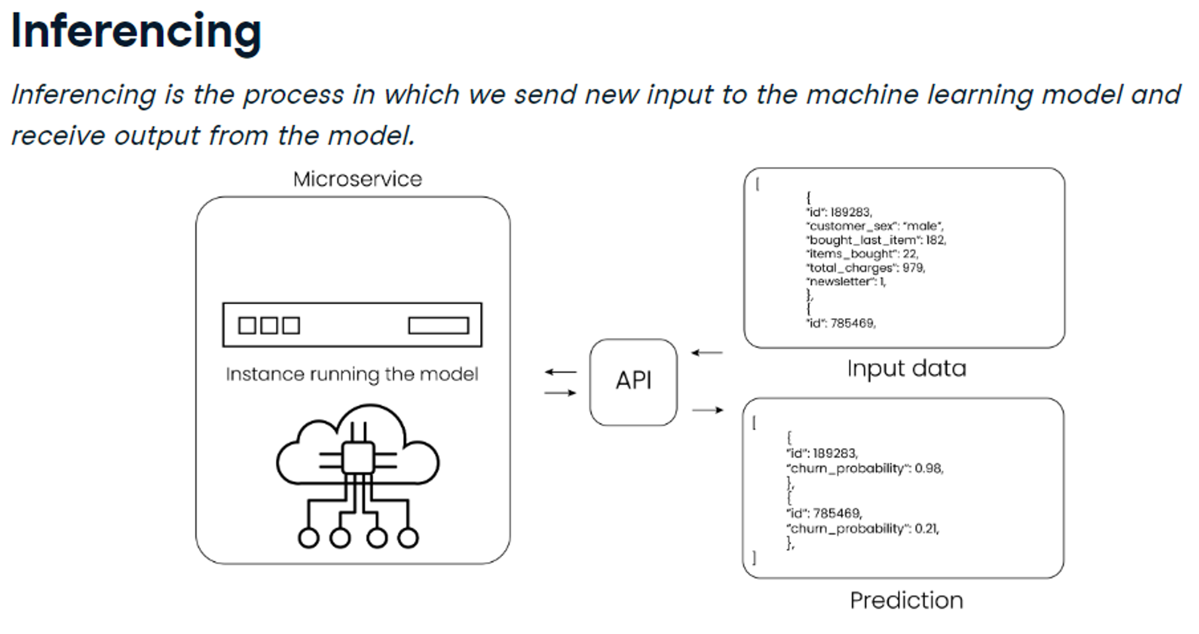
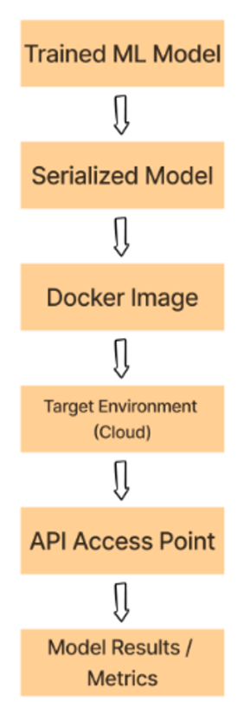

Slide 10
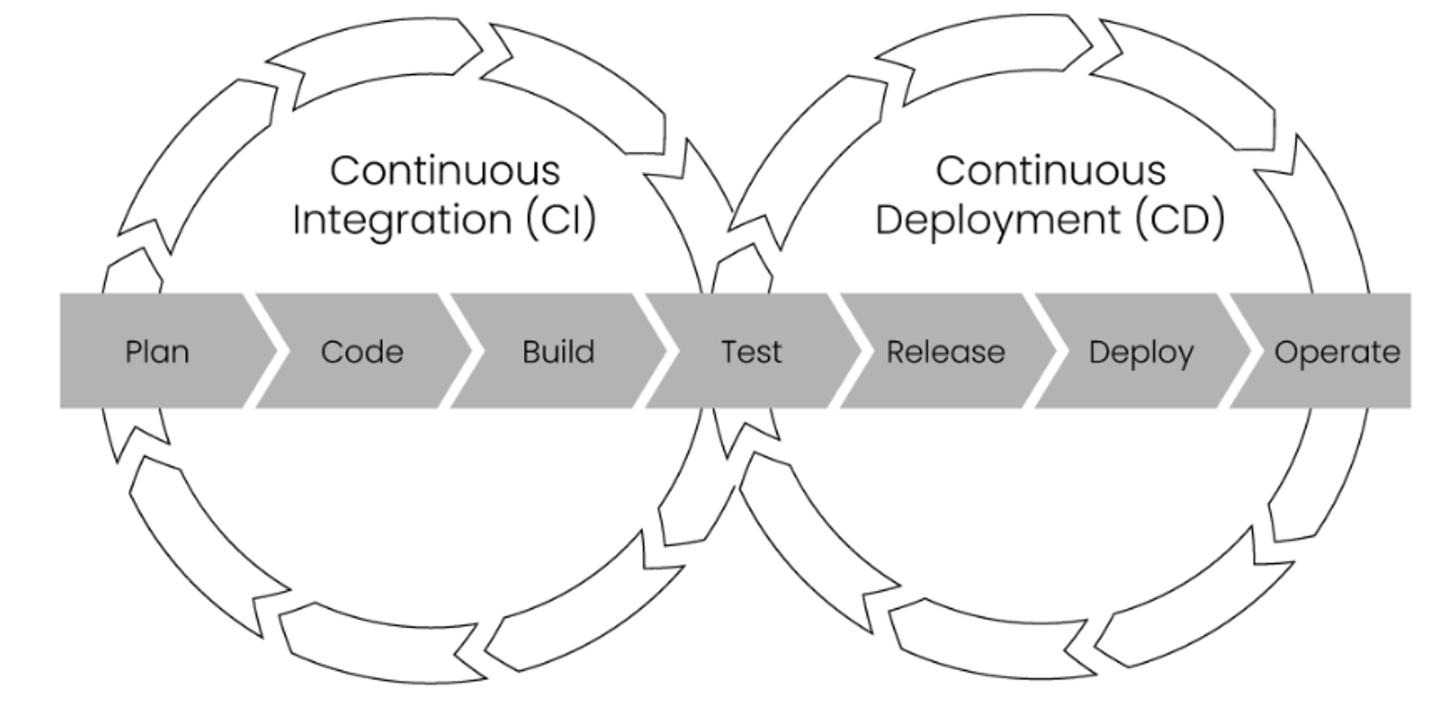
CI/CD Pipeline
CI/CD pipeline is also part of the deployment phase.
It is a series of steps in developing, testing, and deploying the code.
Using a CI/CD pipeline, software developers can easily make incremental changes and then push these changes to the production environment.
Continuous integration is the practice where code changes are continuously integrated quickly and frequently.

Slide 11
Model Monitoring
Types of monitoring
Statistical Monitoring
looking into the input data, and the model output, its predictions.
Computational Monitoring
We can also investigate more technical metrics of the model.
This could be the number of incoming requests that are made, the network usage of the model, or the number of resources a server uses to keep the model running.
Retraining ML Models
Data change is inevitable, so model must be retrained
Data drift: change in input data
Concept drift: change in the relationship between input and output data (patterns that the model was previously trained on do not old anymore)
How fast model’s accuracy goes down is called model degradation

Slide 12
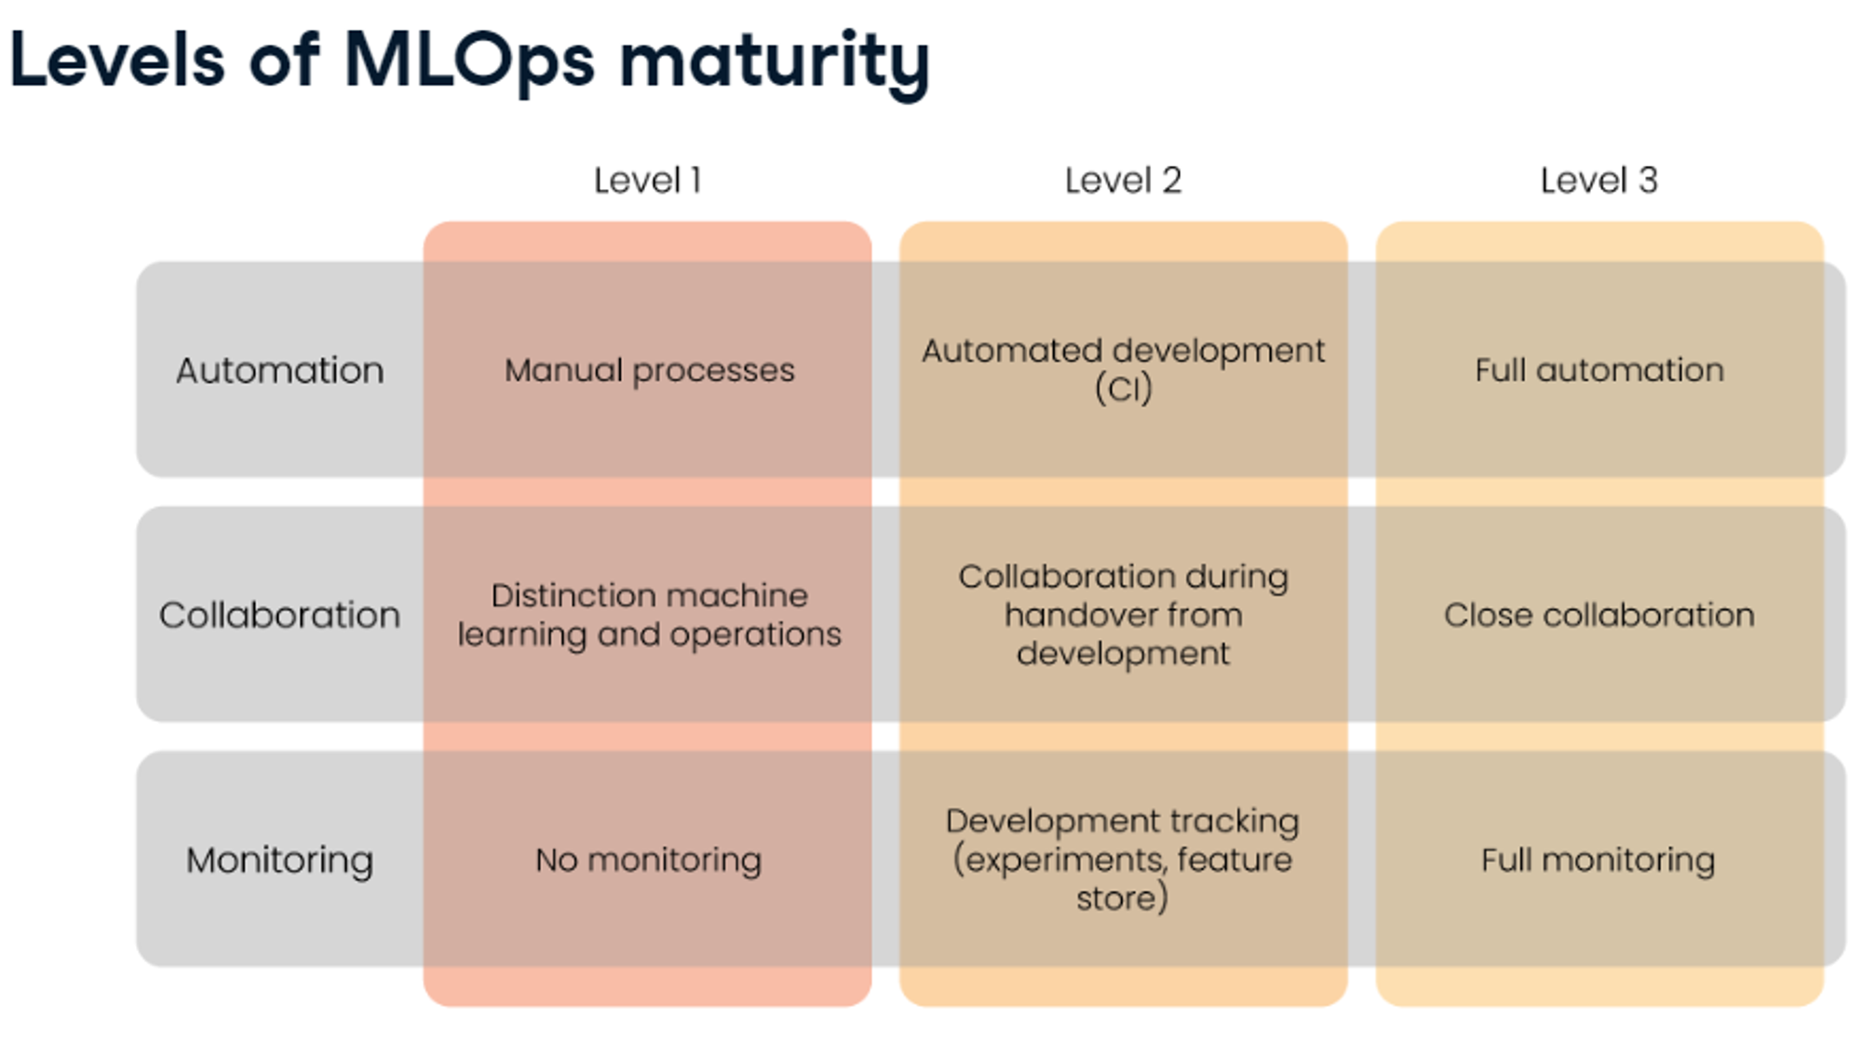

Slide 13
Feature Store:
Feast
Hopsworks
Experiment tracking:
mlflow
clearML
W&B
mlflow and clearml provide full machine learning lifecycle tools
Kubernetees enable automatic deployment and scalability (cloud providers also provide Kubernetes like services)
CI/CD pipelines
Jenkins - opensource
GitLab
Monitoring
fiddler - model monitoring
great expectations - great expectations
Tools for full ML lifecycle - all tools
AWS sagemaker
Azure ML
Google cloud AI platform

Slide 14
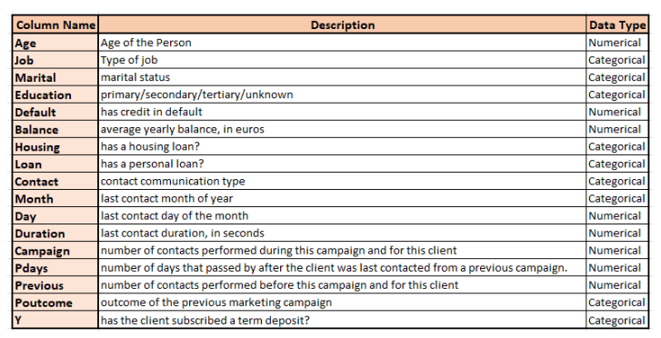
Our Project
Portuguese banking Dataset
The dataset consisted of Campaign information
The goal of classification is to predict whether a client will subscribe to a term deposit.

Slide 15
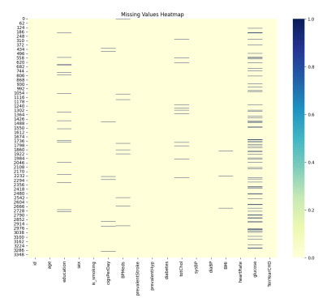
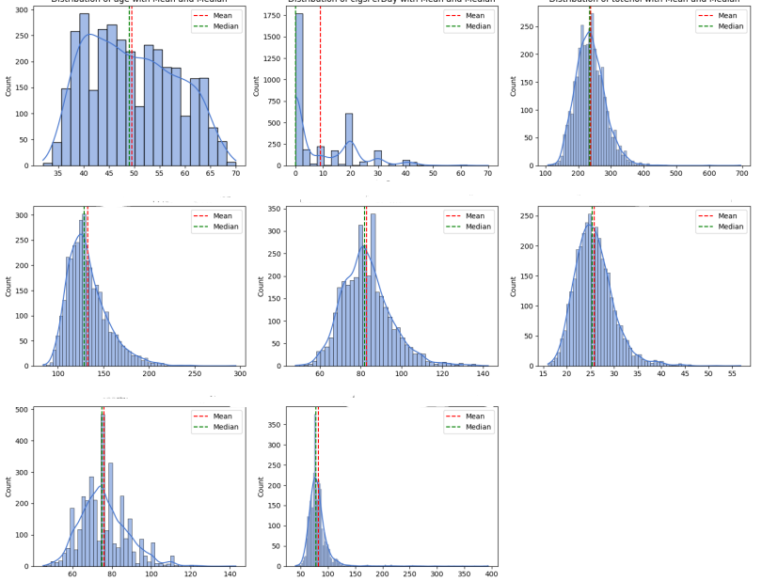
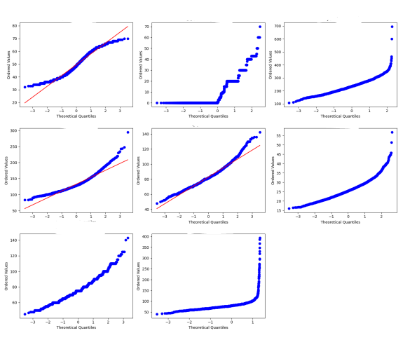
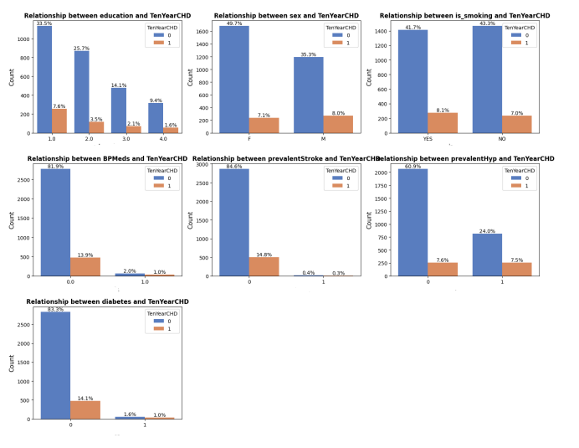
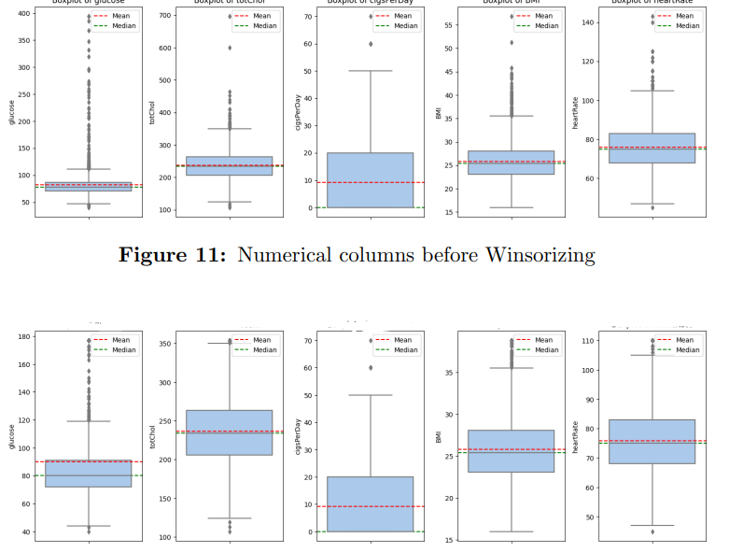
EDA
Correlation Matrix
Dropped features of very high correlation, derived new features
Distribution of categorical columns ( The target variable was highly imalanced)
Imputed Nulls (Iterative Imputer, KNN Imputer)
Performed various mathematical transformations (logarithmic, yeo-johnson)
Performed Standard Scalar
Performed Winsorizing to remove outliers
Feature Selection

Slide 16
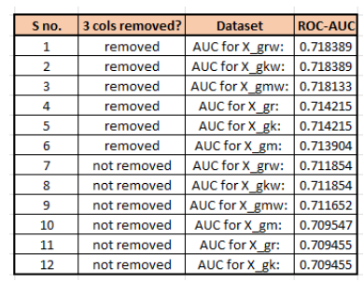
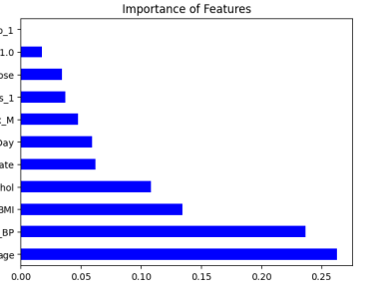
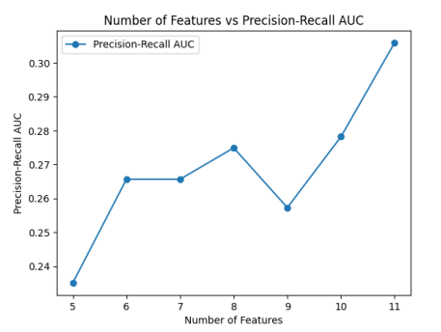
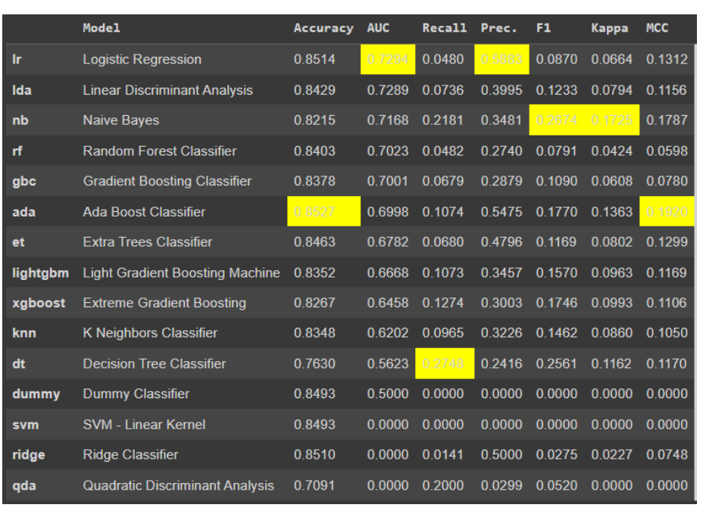
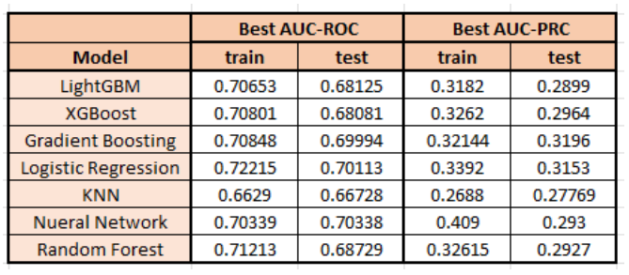
EDA
Correlation Matrix
Dropped features of very high correlation, derived new features
Distribution of categorical columns ( The target variable was highly imalanced)
Imputed Nulls (Iterative Imputer, KNN Imputer)
Performed various mathematical transformations (logarithmic, yeo-johnson)
Performed Standard Scalar
Performed Winsorizing to remove outliers
Feature Selection

Slide 17
